Slide 1



fullstackdatascience.com
Lesson 11 - Domain Knowledge
Ecommerce - Sales
Power BI
Created by Huydata
DA K6
Lesson 3
huynt@fullstackdatascience.com
1

Slide 2

Learn
About
01/
Domain Knowledge
Ecommerce - Sales
02/
Lab
fullstackdatascience.com
2

Slide 3
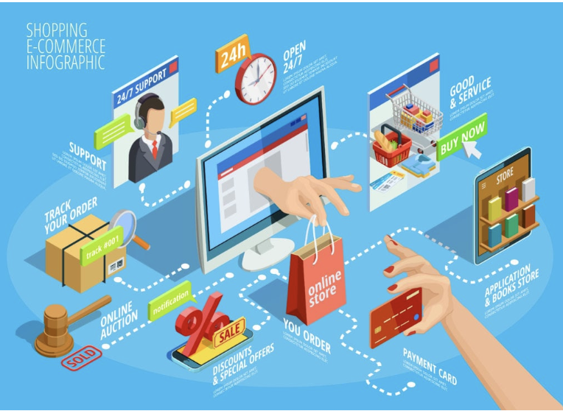
Ecommerce
Sales
Ecommerce is the electronic buying and selling of goods and services, usually via the internet
3

Slide 4
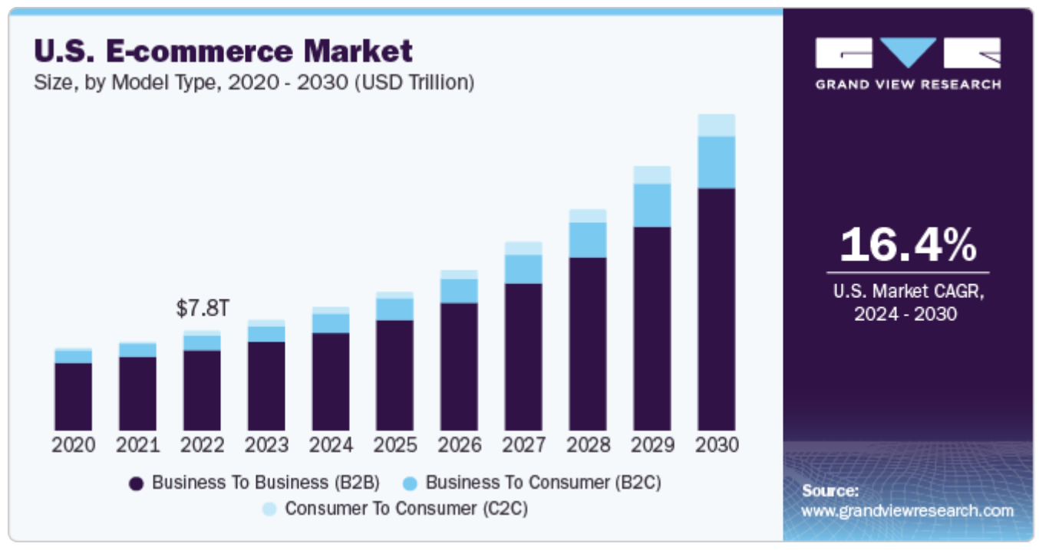
Market Size
5

Slide 5
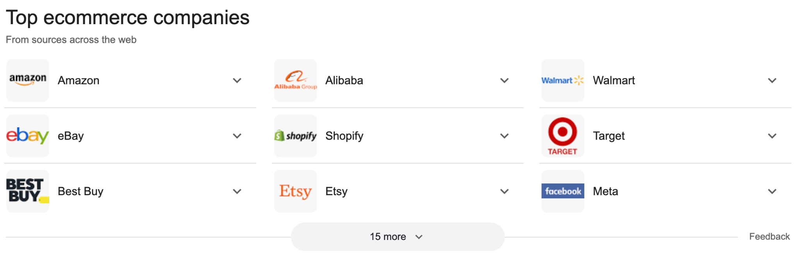
Top Companies
5

Slide 6

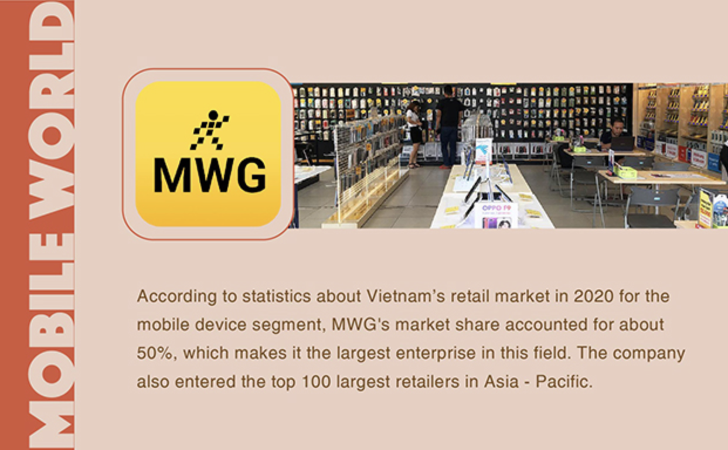


Top e-commerce companies in Vietnam
5

Slide 7
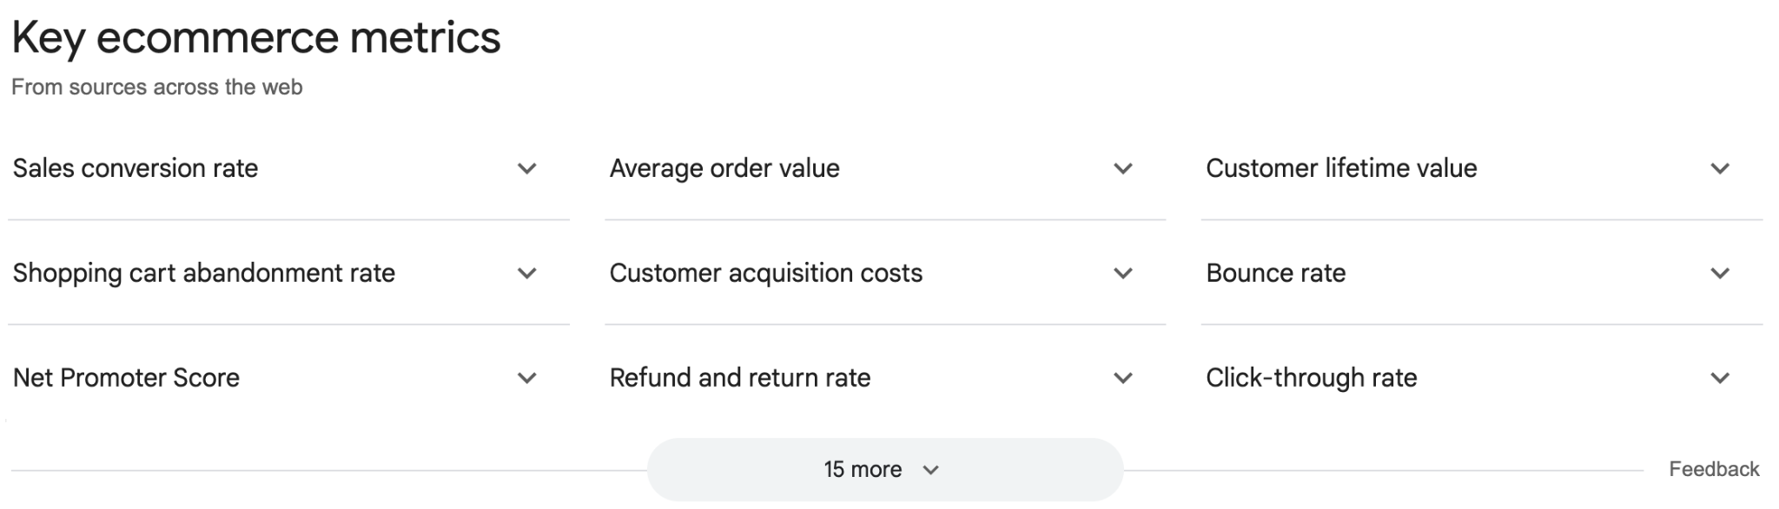
Key Metrics in Ecommerce/Sales
5

Slide 8

Practices
3

Slide 9
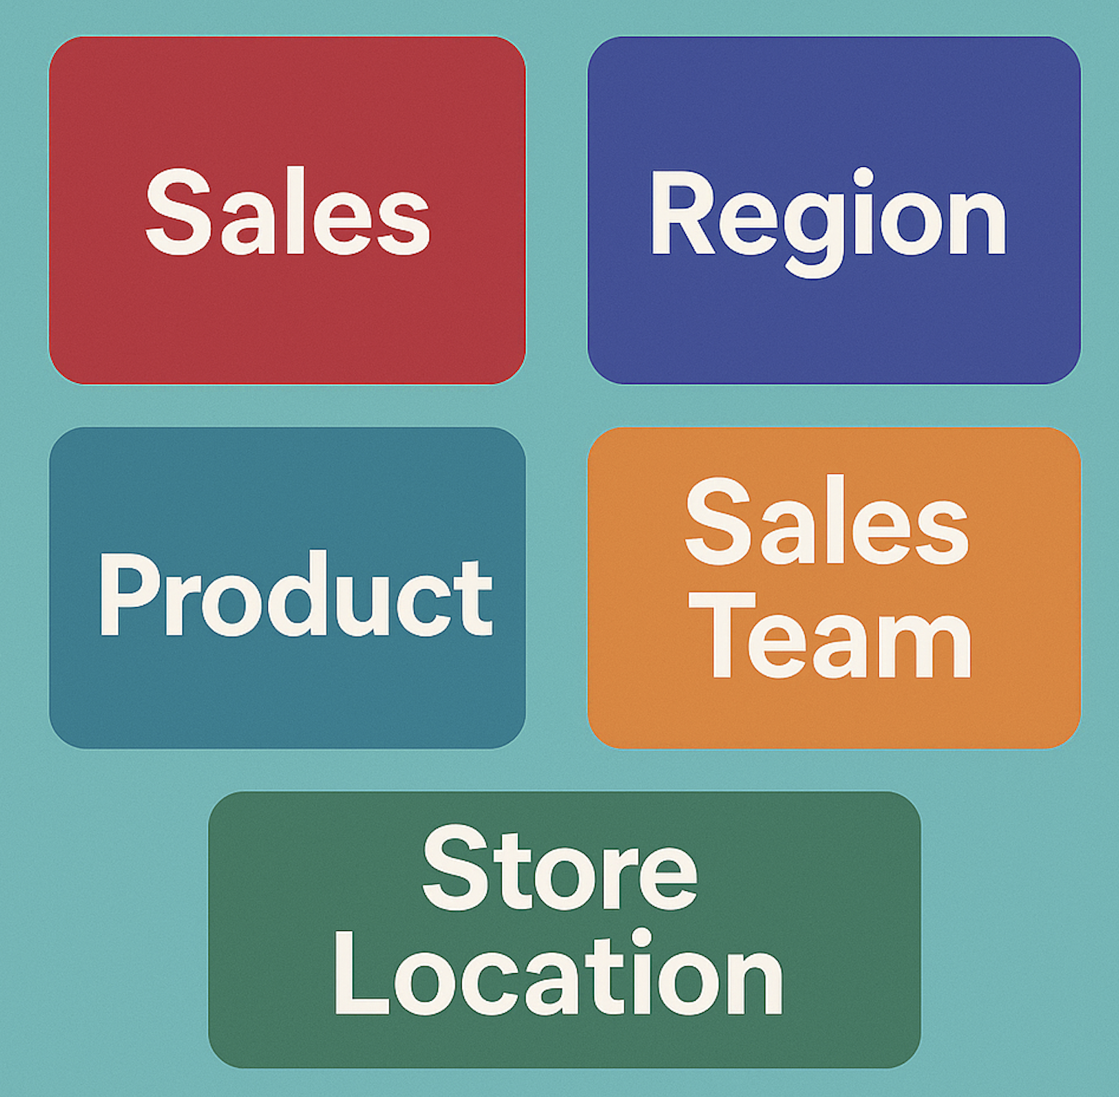
Sales Report
As a data analyst at a large retail company, you are tasked with developing a sales performance summary report for the executive team.
This report is designed to provide an overview of sales performance, while ensuring that the information is presented in a clear, positive, and understandable manner to senior management.
5

Slide 10

fullstackdatascience.com
References
https://dataedo.com/samples/html/Data_warehouse/doc/AdventureWorksDW_4/home.html
11

Slide 11





Thank you
096 574 90 25
CREATED BY
Nguyen Tien Huy
info@robusto.ai
fullstackdatascience
huynt@fullstackdatascience.com
Data Manager
https://fullstackdatascience.com/
Hanoi, Vietnam

